Slide 1

Name of the School: School of Computer Science & Engineering
Course Code: BBSO1T1002 Course Name: Semi Conductor Physics
Team Member Details:
1.Ankur Srivastava (21SCSE1011195)
2 Ansh Kumar Srivastava (21SCSE1011158)
3.Arthved Arya(21SCSE1011121)
4.Ashish Kumar (21SCSE1011140)
5.Ashish Kumar Shah (21SCSE1011173)
Semester: II Section:16
Student Name: Program Name:

Slide 2
PRINCIPLE OF SOLID AND GAS LASER – IMPORTANCE IN INDUSTRY AND MEDICAL
Name of the School: School of Computer Science & Engineering
Course Code: BBSO1T1002 Course Name: Semi Conductor Physics
TOPIC

Slide 3
What is laser?
Name of the School: School of Computer Science & Engineering
Course Code: BBSO1T1002 Course Name: Semi Conductor Physics
LASER is an abbreviation of Light Amplification by Stimulated Emission of Radiation.
Lasers are light beams so powerful that they can travel miles into the sky, and they can also cut through the surfaces of metals.
Theodore H Maimane at Hughes Research Laboratories was the first person to build a practical laser in 1960.
Today lasers find applications in various fields and there are different types of lasers with numerous applications.

Slide 4
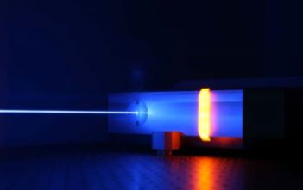
Solid-State laser
Name of the School: School of Computer Science & Engineering
Course Code: BBSO1T1002 Course Name: Semi Conductor Physics
The solid-state laser is a type of laser where the medium used is solid. The solid material used in these lasers is either glass or crystalline materials.

Slide 5
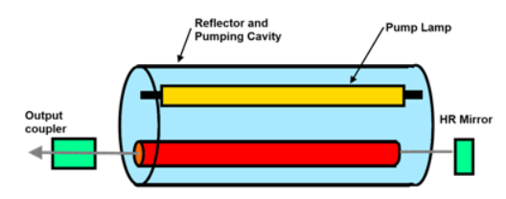
Working Of solid-state laser
Name of the School: School of Computer Science & Engineering
Course Code: BBSO1T1002 Course Name: Semi Conductor Physics
Glass or crystalline materials used in a solid-state laser are used as impurities in the form of ions along with the host material. Doping is the term used for describing the process of addition of impurities to the substance.
The dopants that are used in this type of laser are terbium (Tb), erbium (Eu), and cerium (Ce) which are rare earth elements. The host materials are ytterbium-doped glass, neodymium-doped yttrium aluminum garnet, neodymium-doped glass and sapphire. The most commonly used host material is neodymium-doped yttrium aluminum garnet.

Slide 6
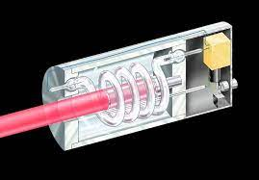
Application of solid-state laser
Name of the School: School of Computer Science & Engineering
Course Code: BBSO1T1002 Course Name: Semi Conductor Physics
It is used as a high-power source of Pulse coherent radiation in interferometry and pulsed holography.
It is used for drilling brittle material, soldering, welding, and in-range finding.

Slide 7
Importance of Solid laser in industry and Medical
Name of the School: School of Computer Science & Engineering
Course Code: BBSO1T1002 Course Name: Semi Conductor Physics
Oxyhaemoglobin (in blood): the blood's oxygen carrying protein, absorption of UV and blue and green light. Lasers for selective absorption include excimer, argon, KTP, Dye and Ruby. Melanin: a pigment in skin, hair, moles, etc: absorption in visible and near IR light (400nm - 1000nm). Lasers for selective absorption in melanin include Diode and Nd: YAG Water (in tissues): transparent to visible light but strong absorption of UV light below 300nm and IR over 1300nm. Lasers for selective absorption in water molecules in tissues include Ho: YAG, Er: YAG and CO₂.

Slide 8
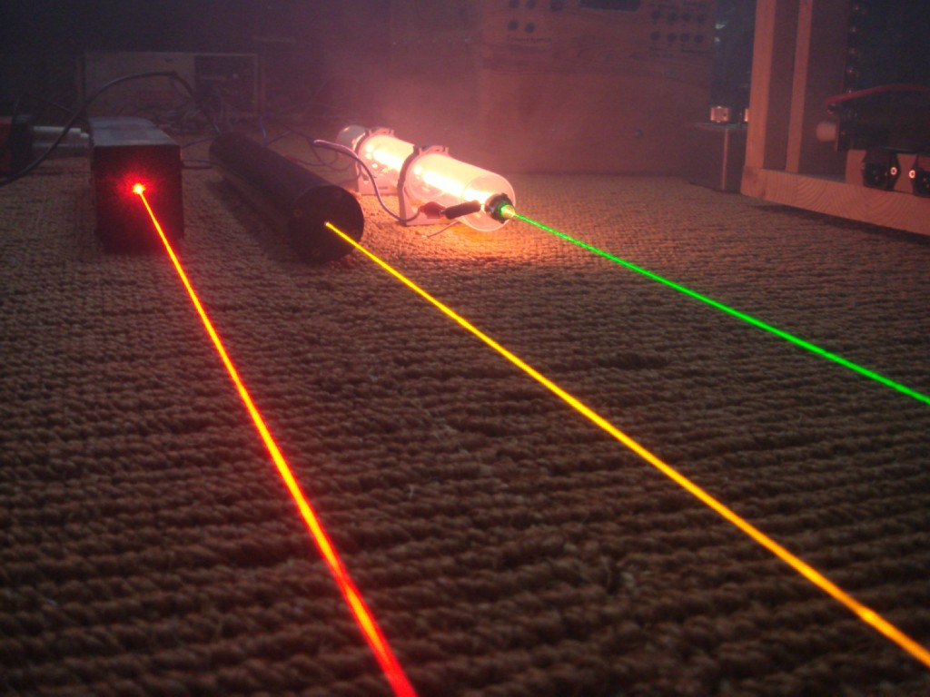
GAS LASER
Name of the School: School of Computer Science & Engineering
Course Code: BBSO1T1002 Course Name: Semi Conductor Physics
A gas laser is a laser in which an electric current is discharged through a gas to produce coherent light. The gas laser was the first continuous-light laser and the first laser to operate on the principle of converting electrical energy to a laser light output. The first gas laser, the Helium–neon laser (He Ne), was co-invented by Iranian-American engineer and scientist Ali Javan and American physicist William R. Bennett, Jr., in 1960. It produced a coherent light beam in the infrared region of the spectrum at 1.15 micrometres

Slide 9
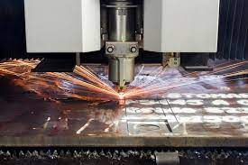
Application of GAS LASER
Name of the School: School of Computer Science & Engineering
Course Code: BBSO1T1002 Course Name: Semi Conductor Physics
The CO2 laser is a mixture of various gases like carbon dioxide, nitrogen, helium, xenon and/or water vapor, and even hydrogen sometimes.
Due to their high power capabilities, CO2 lasers are widely used in industrial applications for cutting, engraving, and welding.

Slide 10
PRINCIPLE OF GAS LASER
Name of the School: School of Computer Science & Engineering
Course Code: BBSO1T1002 Course Name: Semi Conductor Physics
The Helium-Neon laser was the first continuous laser. It was invented by Javan, Bennett and Harriot in 1961. The laser has three components Laser medium: it is in the form of He-Ne gas mixture Pumping process:
The inelastic atom-atom collision Resonator cavity: it is made of a full reflector and a partially reflecting plates parallel with high accuracy He-Ne gas laser is the four energy levels in which first He atoms are excited to bring the Ne atoms in required excited state by the atom-atom inelastic collision pumping process, the population inversion is achieved between the metastable and ground states.

Slide 11
Importance of gas laser in industry and MeDICAL
Name of the School: School of Computer Science & Engineering
Course Code: BBSO1T1002 Course Name: Semi Conductor Physics
In Industry, Gas lasers have a wide range of uses. For example, carbon dioxide gas lasers have applications in industry, such as for cutting and welding. Helium-neon lasers are often used in physics labs and other educational settings and tend to be the least expensive. The HE-Ne or helium-neon laser can be used to make holograms and ion lasers can be used for CW dye laser pumping.
In Medical, it closes lymph vessels to prevent tumor cells from spreading, and seals the cut ends of nerves to prevent the formation of a neuroma. It is used in ENT, gynecology, plastic and maxillofacial surgery, and urology. It cannot be carried by flexible fibers at present.

Slide 12


